Slide 1
Quality Control part 2

Slide 2
Different Mechanisms for Quality Control
Aggregation and redundancy
Embedded gold standard data
Economic incentives
Reputation systems
Statistical models

Slide 3
Reputation systems
Mechanical Turk uses a reputation system
Each Turker has a small number of variables associated with them, that are exposed to Requesters
Past approval rate
Number of HITs approved
Has masters qualification (photo moderation/ categorization master)

Slide 4
Pros and Cons of MTurk’s reputation system
Pros | Cons
Gives a bit information about what other Requesters thought of a Worker | Reasons for rejections not shared; Weights all Requesters equally
Allows you to select Amazon’s master’s qualification, which is given to experienced Workers | It is not clear who gets the master’s qual. No way to share other qualifications.
 | Asymmetric: applies only to Workers, with no way to rate Requesters
Notes:
Others?

Slide 5
Confederated Trust
Acceptance rate doesn’t show how good a worker is at a particular task
Qualifications like the “photo moderation master’s” may show this
However, there is no way to share this information with other requesters
Lots of reinventing the wheel

Slide 6
Confederated Trust
Do you think it would be useful to share qualifications among requesters?
How would you do it?

Slide 7
Asymmetric reputation systems
No way for Turkers to rate requesters, and see beforehand who is scrupulous
Turkers have built their own external tools for this like TurkOpticon
No way to see whether a Turkers high rating comes from good Requesters

Slide 8
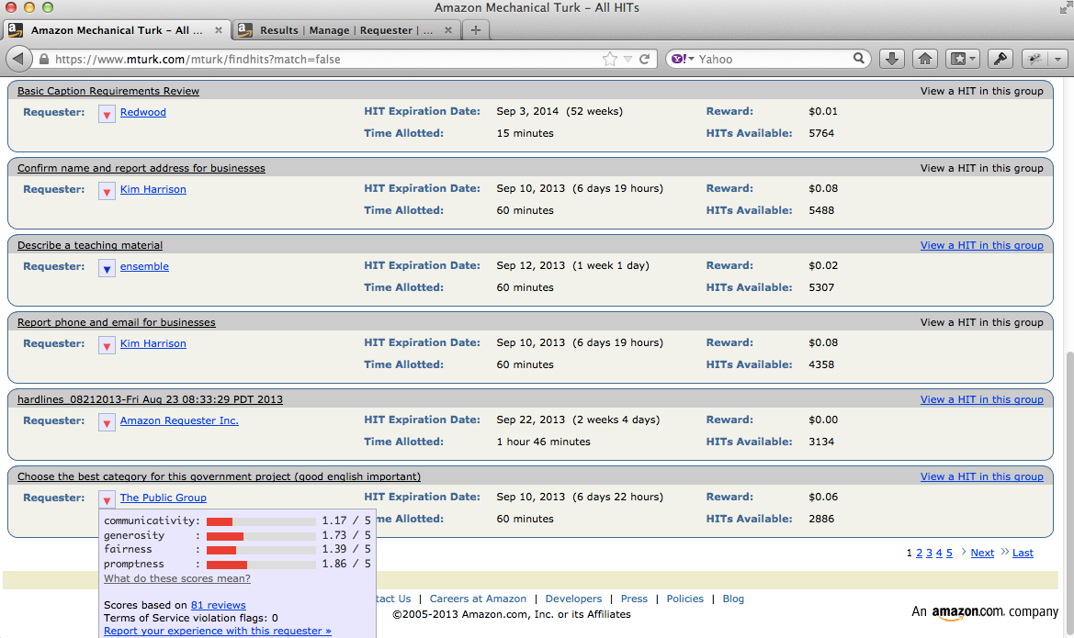
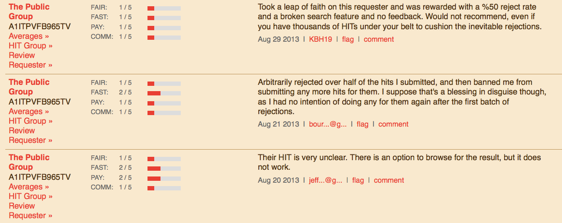

Slide 9
Qualitative v Quantitative
TurkOpticon's qualitative attributes | CrowdWorker's quantitative equivalents
promptness: How promptly has this requester approved your work and paid? | Expected time to payment: On average, how much time elapses between submitting work to this Requester and receiving payment?
generosity: How well has this requester paid for the amount of time their HITs take? | Average hourly rate: What is the average hourly rate that other Turker make when they do this requester's HITs?
fairness: How fair has this requester been in approving or rejecting your work? | Approval/rejection rates: What percent of assignments does this Requester approve? What percent of first-time Workers get any work rejected?
communicativity: How responsive has this requester been to communications or concerns you have raised? | Reasons for rejection: Archive of all of the reasons for Workers being rejected or blocked by this Requester.

Slide 10
Amazon’s other reputation system
Amazon has another reputation system in place for its online stores
Amazon allows anyone to list and sell items through its site, and to set their own prices
These can be individuals selling used goods, or independent 3rd party sellers who use Amazon to reach a larger customer base
How does Amazon ensure good customer experience?

Slide 11
Feedback from buyers
How satisfied were you with how your order was packaged and shipped?
If you contacted the third-party seller, did you get good customer service and prompt resolution?
Would you buy from this third-party seller again?

Slide 12

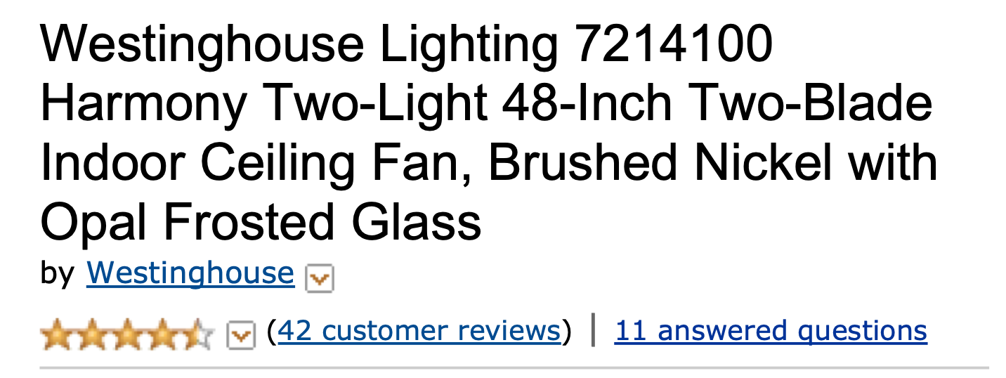

Slide 13
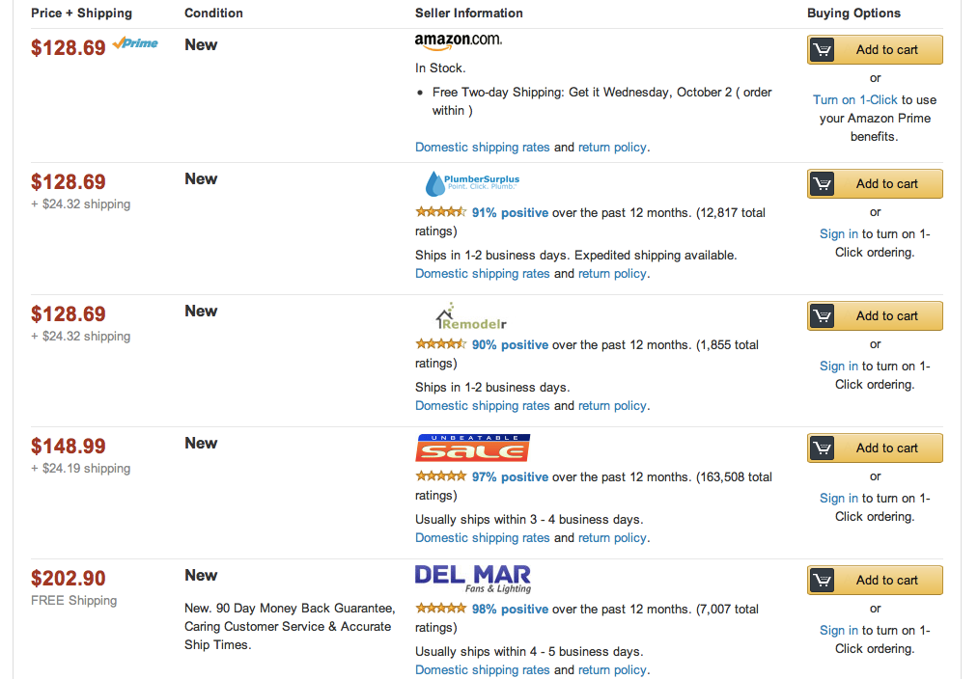


Slide 14
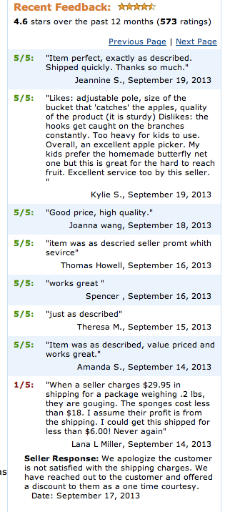
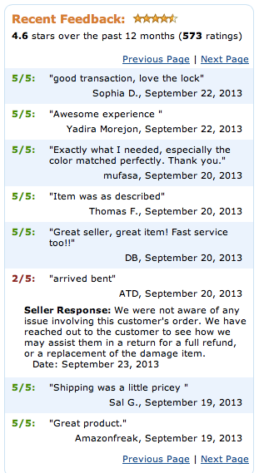

Slide 15
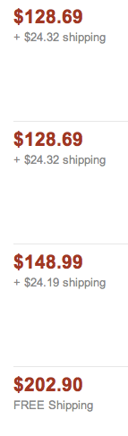
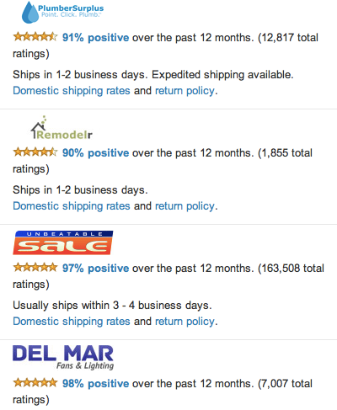
What are the economic implications of poor feedback?

Slide 16
Price premium
Multiple sellers all selling the same item, but at different prices
Price premium is the difference between a cheaper listing and a more expensive listing
When someone opts for the more expensive item, even though it is identical, what is the reason for paying the premium?

Slide 17
Data-driven analysis
Panos Ipeirotis harvested data from Amazon’s website
Gathered transaction data by repeatedly visiting listings (every 8 hours) and tracking when one item sold
Gathered reputation data for each merchant. Complete history of numerical scores and text-based feedback
Notes:
Amazon Web Services associates a unique transaction ID for each unique product listed by a seller. This transaction ID enables us to distinguish between multiple or successive listings of identical products sold by the same merchant.

Slide 18
Data-driven analysis
Data set gathered over half a year period
Transaction data contains 1,078 merchants, 9,484 unique transactions and 107,922 price premiums
Reputation data contains an average of 4,932 postings for each merchant

Slide 19
NLP + Economics
Quantify the economics impact of sentiment of the feedback evaluations
Using natural language processing techniques to derive semantic orientation and strength of comments

Slide 20
Method
Each merchant’s reputation is represented using a vector of n-dimensions X = (X1, X2, ... XN)
Dimensions were 150 nouns and verbs, values of dimensions could be one of 140 modifiers
X1 is “delivery,” X2 is “packaging,” X3 is “service.”
Feedback 1 “I was impressed by the speedy delivery! Great service!”: (speedy ; NULL; great)
Feedback 2 “The item arrived in awful packaging, and the delivery was slow”: (slow ; awful ; NULL)

Slide 21
Method
Construct a matrix out of all of the feedback for a seller
Weight the more recent feedback more heavily
Calculate how the values of each dimension effect the price premium
Use least-squares regression with fixed effects to predict the price premium

Slide 22
Highest scoring phrases
wonderful experience | $5.86
outstanding seller | $5.76
excellant service | $5.27
lightning delivery | $4.84
highly recommended | $4.15
best seller | $3.80
perfectly packaged | $3.74
excellent condition | $3.53
excellent purchase | $3.22
excellent seller | $2.70
excellent communication | $2.38
perfect item | $1.92
terrific condition | $1.87
top quality | $1.67
awesome service | $1.05
A+++ seller | $1.03
great merchant | $0.93
friendly service | $0.81
easy service | $0.78
never received | -$7.56
defective product | -$6.82
horrible experience | -$6.79
never sent | -$6.69
never recieved | -$5.29
bad experience | -$5.26
cancelled order | -$5.01
never responded | -$4.87
wrong product | -$4.39
not as advertised | -$3.93
poor packaging | -$2.92
late shipping | -$2.89
wrong item | -$2.50
not yet received | -$2.35
still waiting | -$2.25
wrong address | -$1.54
never buy | -$1.48

Slide 23
Predicting the merchant who makes the sale

Slide 24
Challenges for Reputation Systems
Not enough people participate
Feedback tends to be overwhelmingly positive
Reports can be dishonest
Reputation systems are undermined if people can change identities easily
People can milk a good reputation

Slide 25
Insufficient participation
Giving feedback for a reputation system contributes to the public good
However, after some information is available it is easy for people to be "free riders" without contributing anything
Early raters take on a transaction cost (Yelpers risk going to bad restaurants with no reviews)
Solutions?
Notes:
Make every participant submit a rating
Avery􏰀et􏰀al.􏰀1999]􏰀propose 􏰀 a􏰀mechanism􏰀 whereby􏰀 early􏰀 evaluators 􏰀are 􏰀paid 􏰀to 􏰀provide 􏰀information􏰀 and 􏰀later 􏰀evaluators􏰀 pay 􏰀to 􏰀balance 􏰀the 􏰀budget.

Slide 26
Overwhelmingly positive feedback
99% of all feedback on eBay is positive
Part of the problem is reciprocity
Sellers and buyers evaluate each other
Positive ratings are given in the hopes of getting positive ratings in return
Negative ratings are avoided for fear of getting negative feedback as retaliation
Notes:
Solutions to overwhelmingly positive feedback?
1. Anonymous feedback
2. Take non-feedback into account

Slide 27
Dishonest reports
Ballot stuffing - a seller colludes with buyers to give unfairly high ratings
Bad mouthing - collusion to give negative feedback about competitors that they want to drive out of the market

Slide 28
Identity changes
Cheap pseudonyms - easy to disappear and re-register under a new identity with almost zero cost
Can misbehave without paying consequences toward reputation
Notes:
1. Increase the difficulty of changing identities
2. Impose upfront costs to new entrants - ok to discard a past identity but it costs something to start a new one.

Slide 29
Value imbalance exploitations
People who want to commit fraud could first invest in building a good reputation
Ebay exploit: "Riddle for 1¢. No shipping. Positive feedback"
Sellers would take a 29¢ loss to build up positive reputation quickly
Notes:
1. Make details of transactions visible to other users
2. Transaction-weighted reputation systems

Slide 30
Challenges for Crowdsourcing Markets
Reciprocal systems are worse than 1-sided systems in e-commerce.
In e-commerce, only the sellers are likely to behave opportunistically. No need for reciprocal evaluation.
In crowdsourcing, both sides can be fraudulent. So reciprocal markets are important, but they are hard to get right!

Slide 31
Challenges for Crowdsourcing Markets
In e-commerce markets, it is straightforward for buyers to evaluate the quality of the product when they receive it.
In crowdsourcing markets, verifying the correct answer is sometimes as costly as producing it.
This has the potential to significantly reduce participation and/or accuracy of reviews

Slide 32
Challenges for Crowdsourcing Markets
No "price premium" for high quality workers
In e-commerce markets, sellers with a good reputation can sell their goods at a relatively high price (premium)
In crowdsourcing, the requester sets the price, and this is typically the same for all workers

